Slide 1
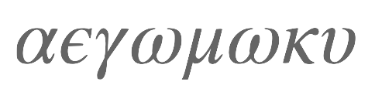
Alpha Epsilon Gomoku
Alpha (almost) Zero on a notebook

Slide 2
Alpha Zero
Silver, David ; Schrittwieser, Julian ; Simonyan, Karen ; Antonoglou, Ioannis ; Huang, Aja ; Guez, Arthur ; Hubert, Thomas ; Baker, Lucas ; Lai, Matthew ; Bolton, Adrian ; Chen, Yutian ; Lillicrap, Timothy ; Hui, Fan ; Sifre, Laurent ; van den Driessche, George ; Graepel, Thore ; Hassabis, Demis: Mastering the game of Go without human knowledge. In: Nature, 550 (2017), S. 354--
Policy-advised graph search (MCTS/UCT)
Start with fresh policy
Self-play thousands of games
Extract UCT visit counts to train the policy
Evaluate new policy against previous by pitting them against each other

Slide 3
Resources
Alpha zero: https://discovery.ucl.ac.uk/id/eprint/10045895/1/agz_unformatted_nature.pdf

Slide 4
Solving* Gomoku
Find a suitable representation of the board
Exploit symmetries
Introduce minimum heuristic to jump-start the learning process (almost zero!)
Find a reasonably-sized, fast learning policy design
Follow the alpha-zero process
* here, ‘solving’ means: demonstrate that the policy does indeed improve in the process

Slide 5
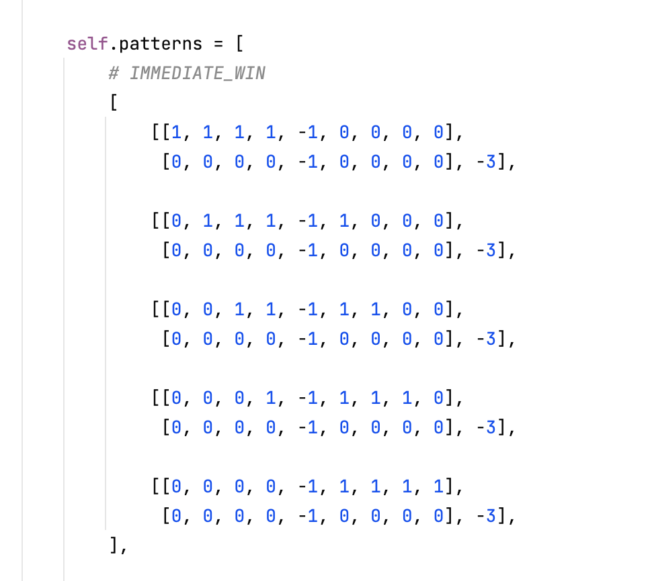
Heuristic Features
This is the ‘epsilon’
We use hard-wired convolutional filters
The central -1 is the position under consideration
Filters are ‘rotated’ by 4 multiples of 45° to account for every possible angle

Slide 6
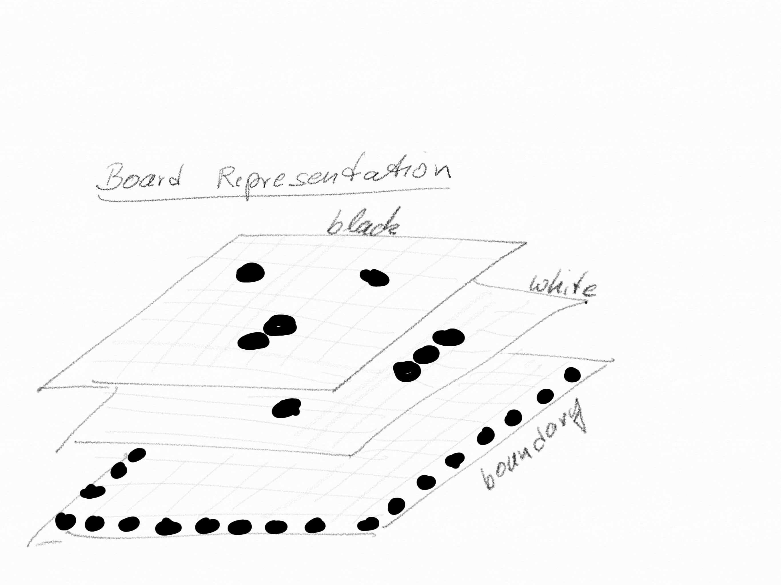
Board Representation
Numpy array 21 x 21 x 3
Current player: channel 0
Other player: channel 1
Boundary stones: channel 2
Translational equivariance!!
Perfection information MDP

Slide 7
Symmetries/Equivariance
Symmetries provide inexpensive source of additional training data
Rotation multiples of 90°
Reflection
Translation Equivariance by design!!
Black/white → current/other

Slide 8
MCTS => PAGS Policy-Advised Graph Search
Monte Carlo Rollouts replaced by value advice.
Initial candidate selection (important!) by policy advice
Graph Search using upper confidence bound: UCT
Exploration: Choose the move with the highest upper confidence bound: c_puct critical for the trade-off
Exploitation (game play): Choose the move with the highest visit count

Slide 9
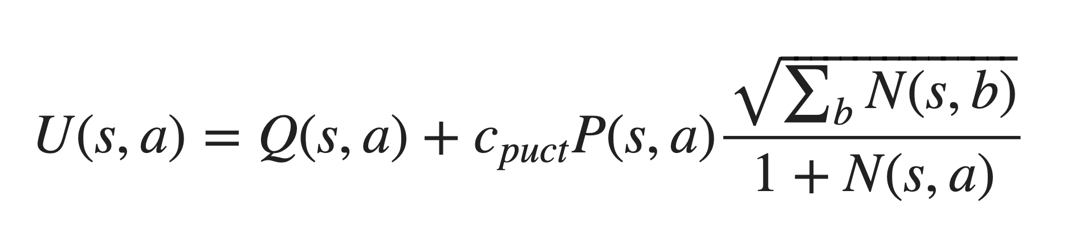
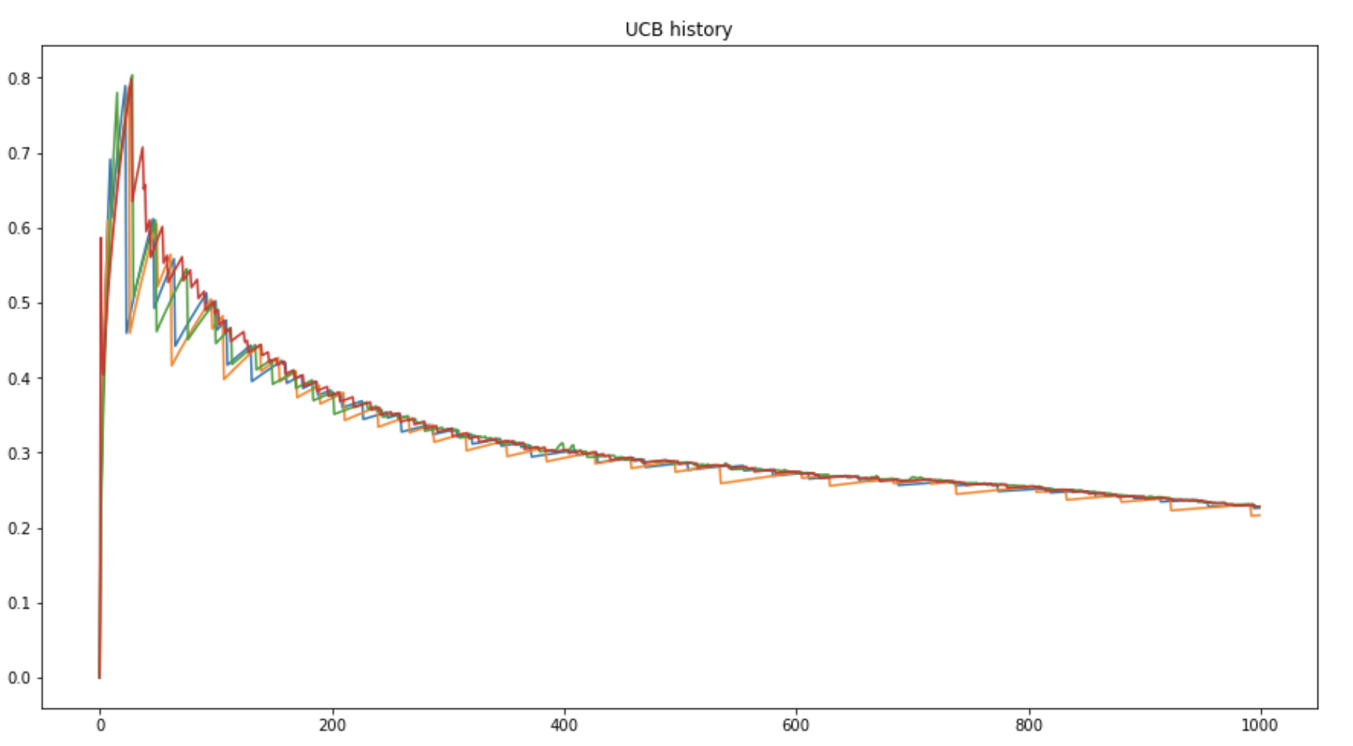
Upper Confidence Bound

Slide 10
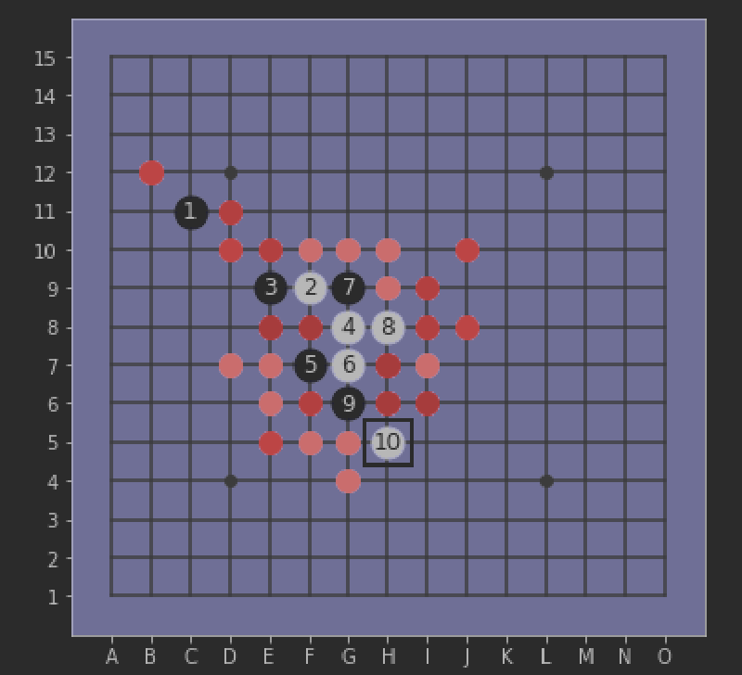
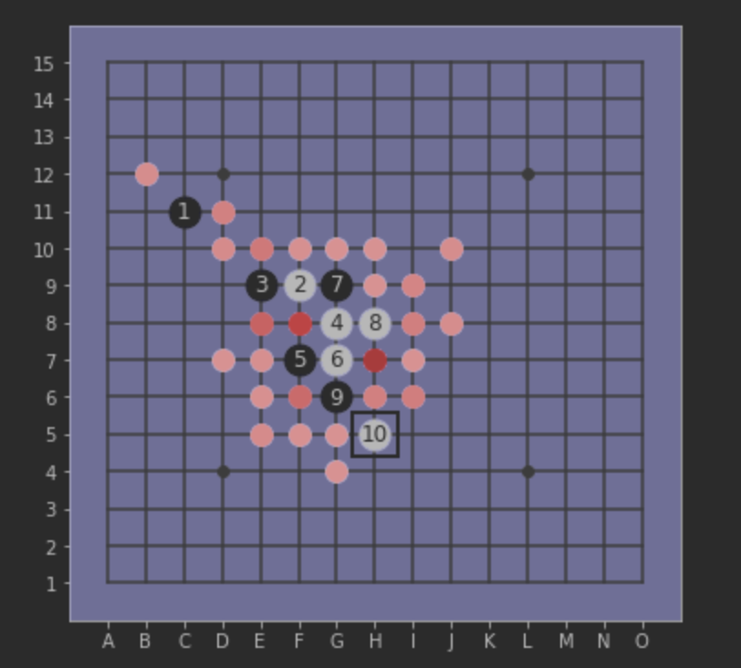
PAGS with UCT in action
See: MCTS_Explore_Exploit.ipynb
UCT Simulation teaches the ANN to focus

Slide 11
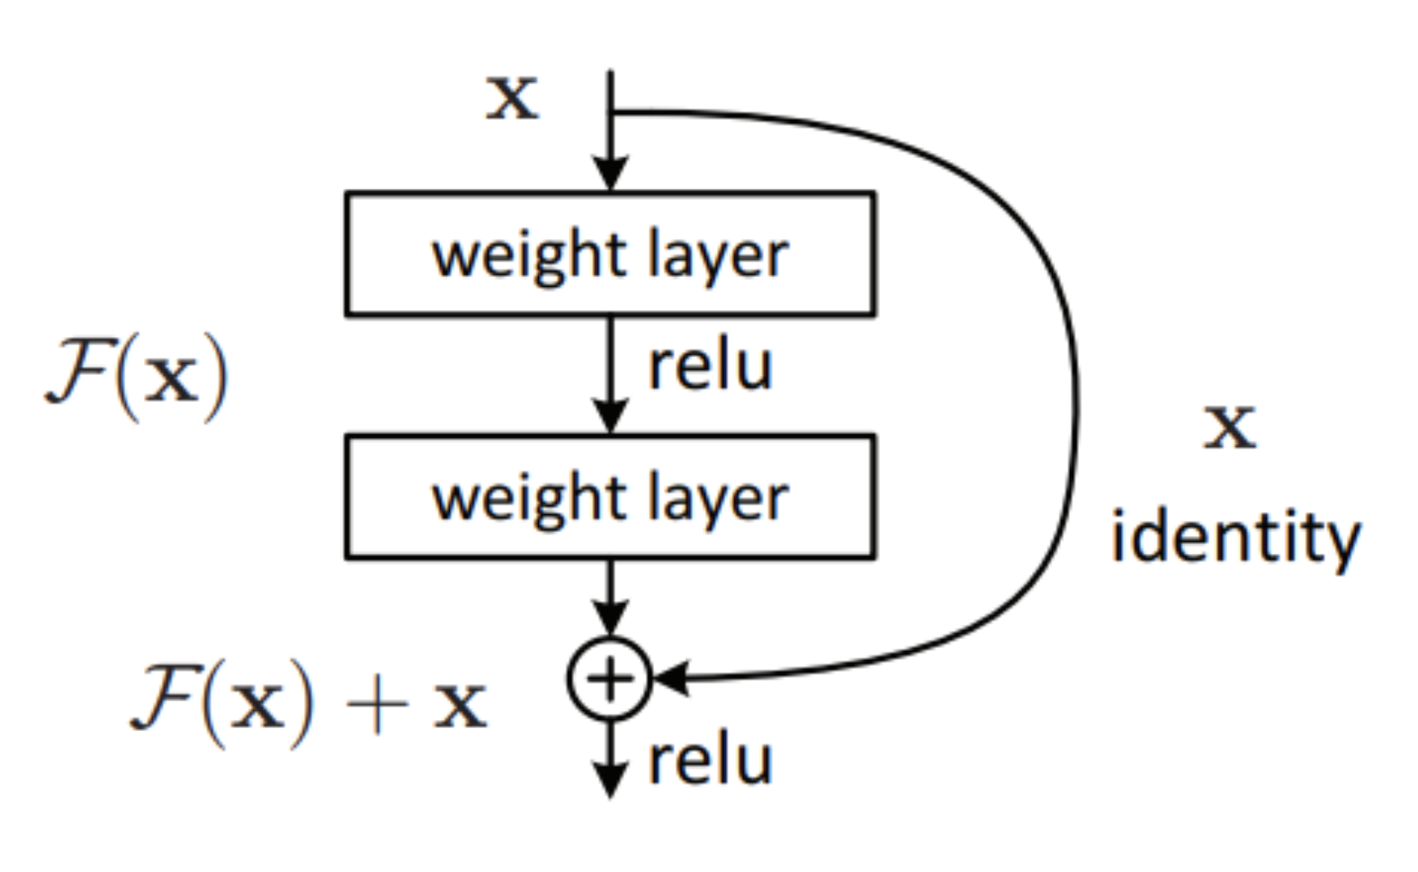
The Neural Network
Policy and value head in one network
Purely convolutional, apart from value head
Based on Resnet with skip connections
Up to 40 blocks
Heuristic Feature head
Reentering input

Slide 12
Training Cycle
Selfplay and record the UTC output
UTC output draws knowledge from the ‘future’
Feed the UTC output into the ANN
ANN generalizes (surprisingly well!)
Better advice next time helps focus explorations
Arena: Let the better advice win

Slide 13
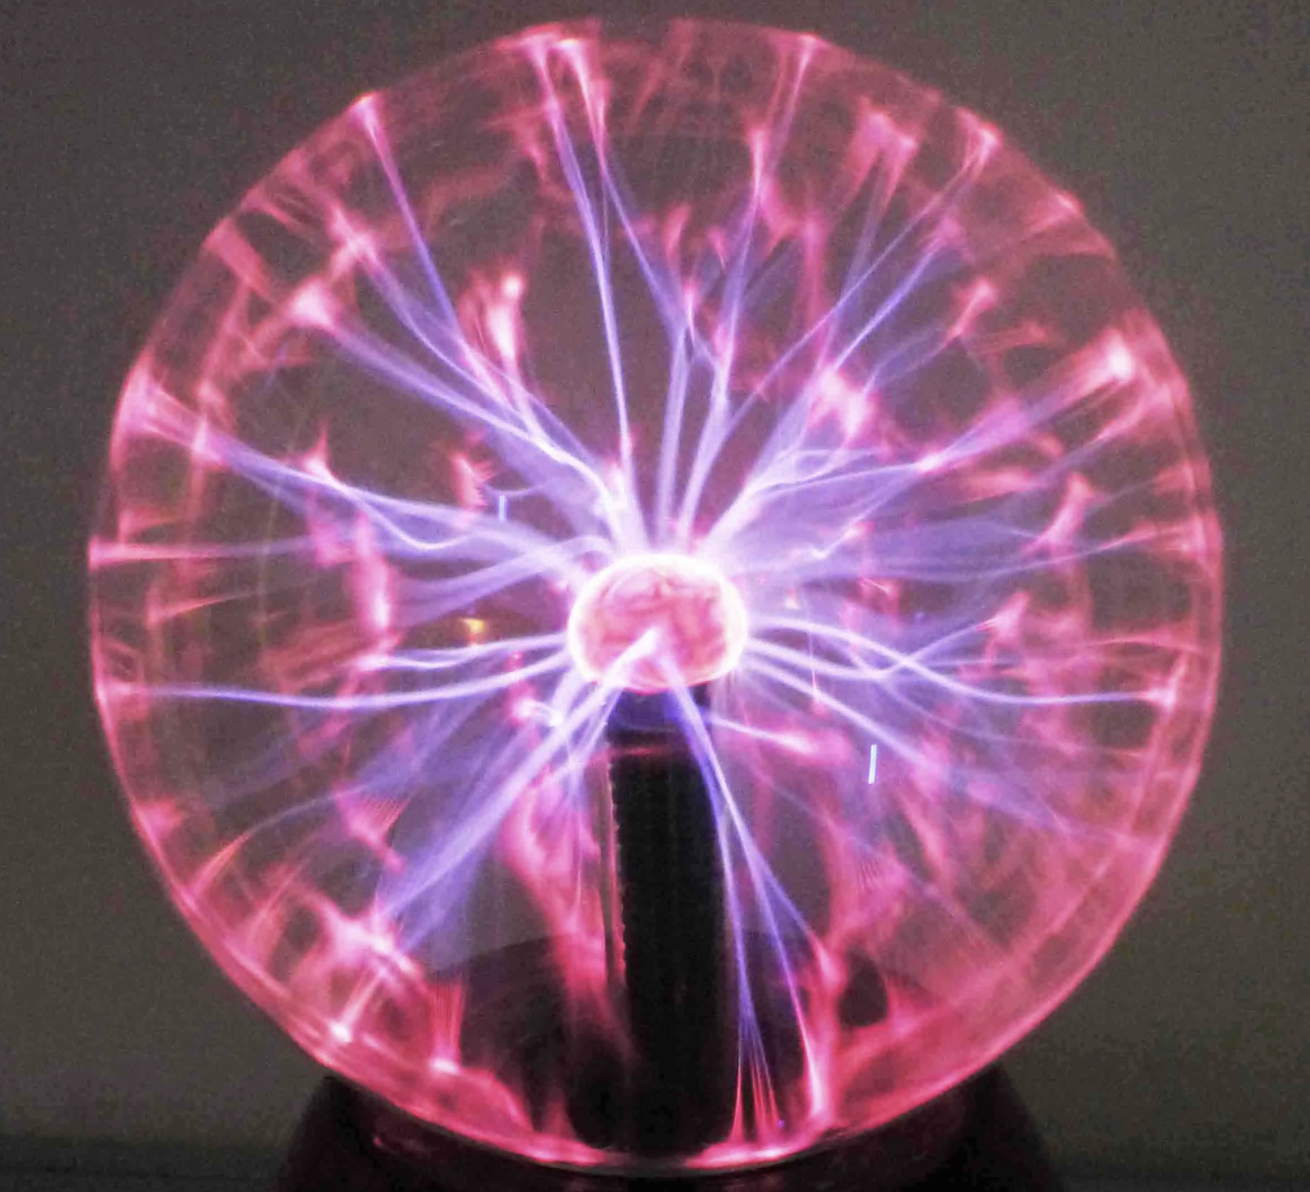
Information flow
We always start from an empty board
Trajectories end with win or loss
UCT propagates that information backwards
Exploration feeds the short term memory that feeds into the intuition that advised further exploration.

Slide 14
The Project
Github: https://github.com/Project-Ellie/DeepGomoku
Explanatory Notebooks in /notebooks
play_a_game.py lets you play vs the AI
create_gameplay_data.sh: starts 12 parallel processes
This presentation

Slide 15
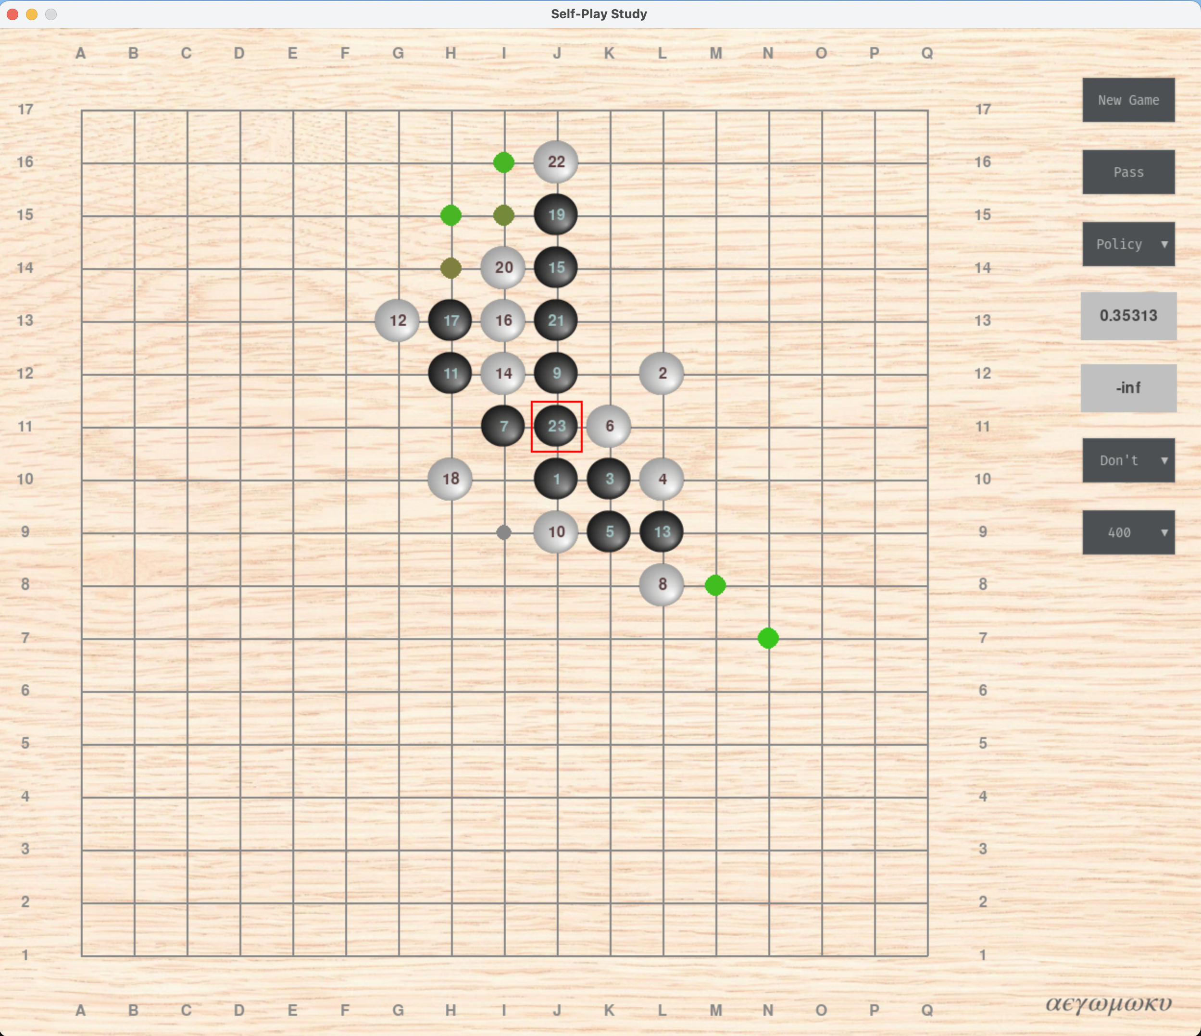
Wooden board with marble stones

Slide 16
Open Questions
Maybe human intelligence is significantly overrated?
Can I improve my learning and my decision making by explicitly mimicking the process?

Slide 17
Thinking Fast And Slow
A MUST Read: Kahnemann’s book!
Surprising similarity with human learning and decision making
Researchers now dare to compare human and artificial intelligence
I learned how to learn…;-)

Slide 18
What’s left to do?
Continue documentation and references
Improve the process
Use cloud resources
Implement Swap-2 opening rules
Game server
Continue training so that alpha epsilon beats at least me consistently.

Slide 19
Title
bullet

Slide 20
Title
bullet

Slide 21
Title
bullet

Slide 22
Title
bullet

Slide 23
Title
bullet

